Slide 1
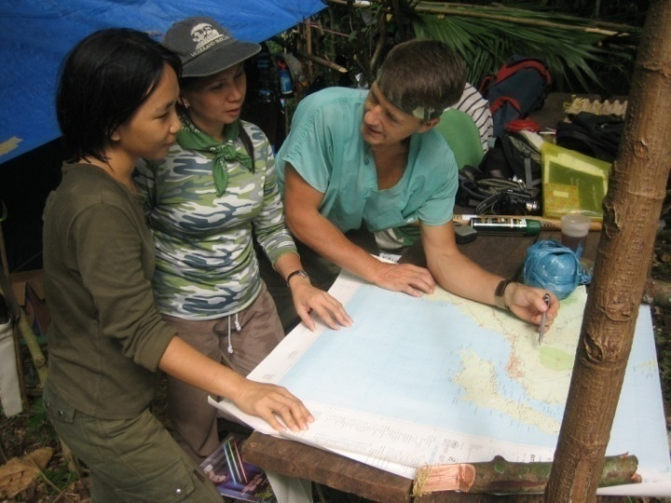
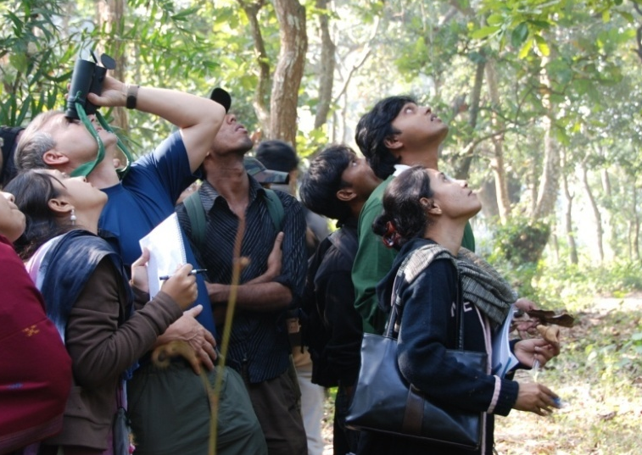
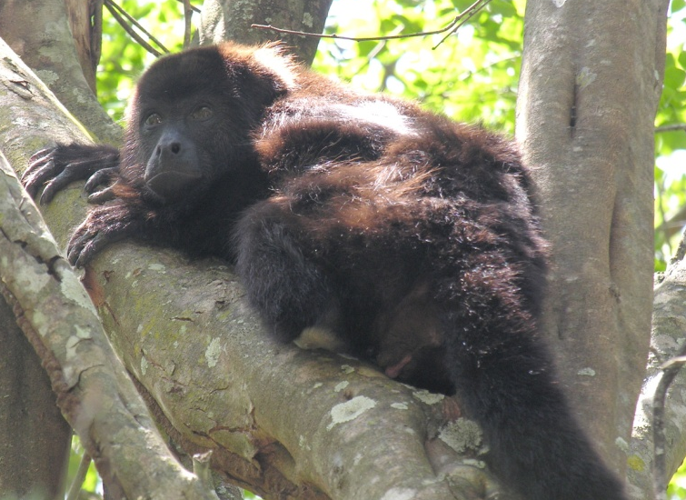
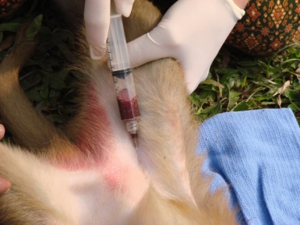
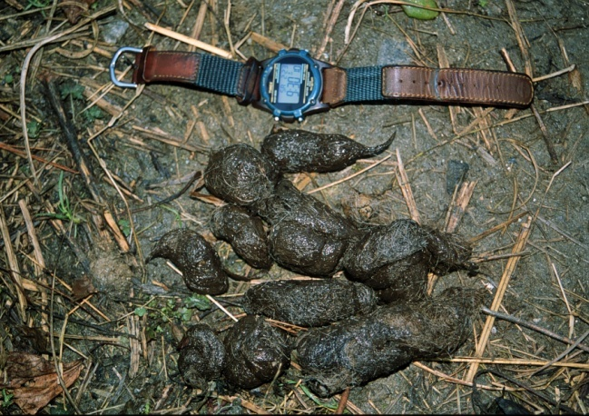
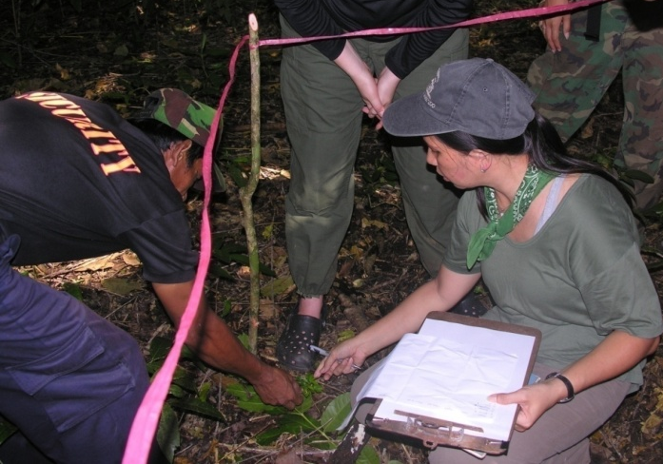
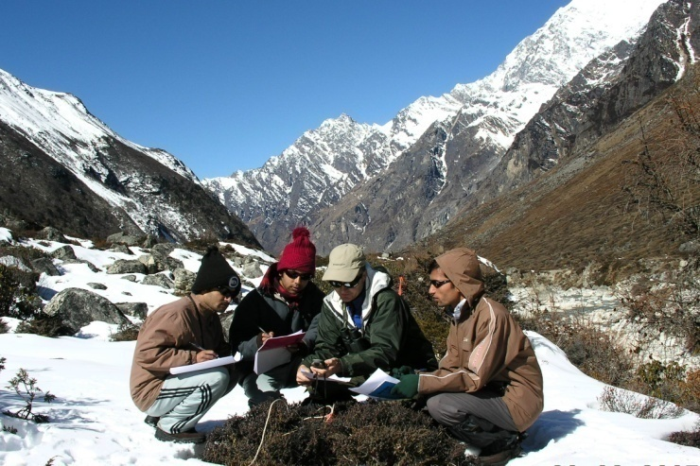
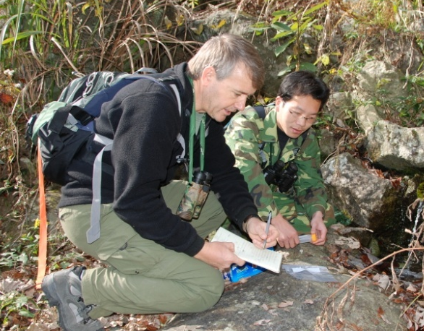
© R. KYES
Field Study Methods

Slide 2
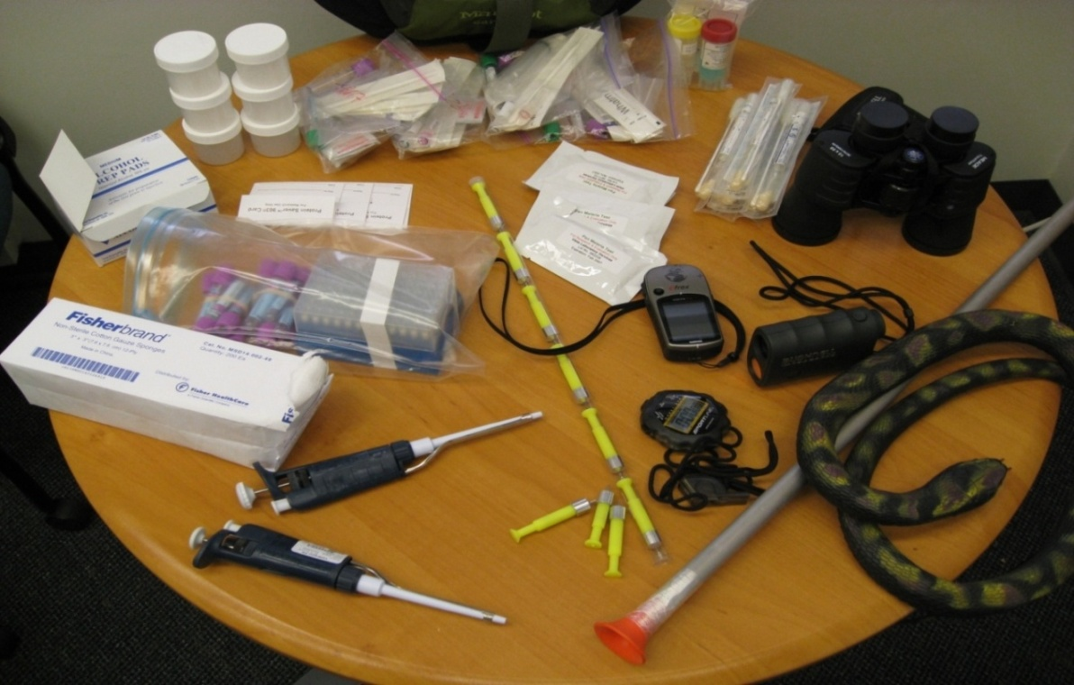
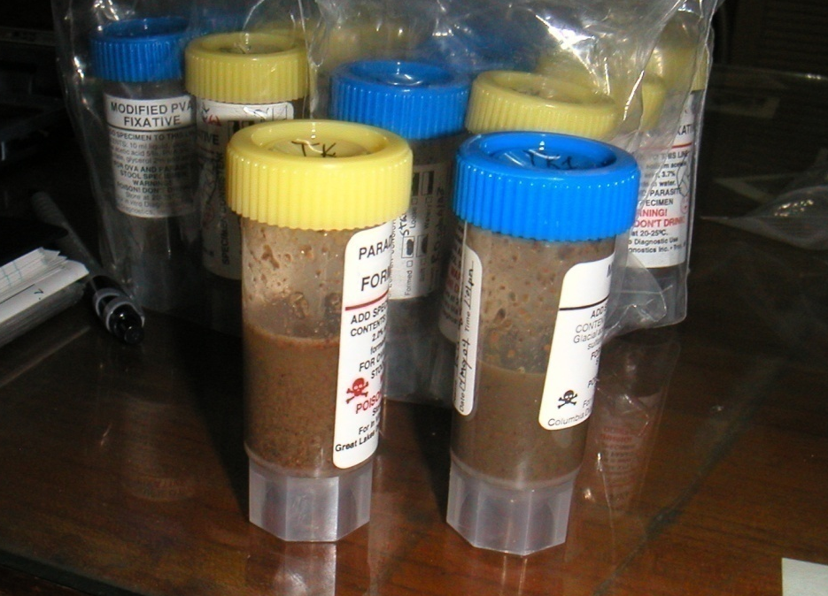
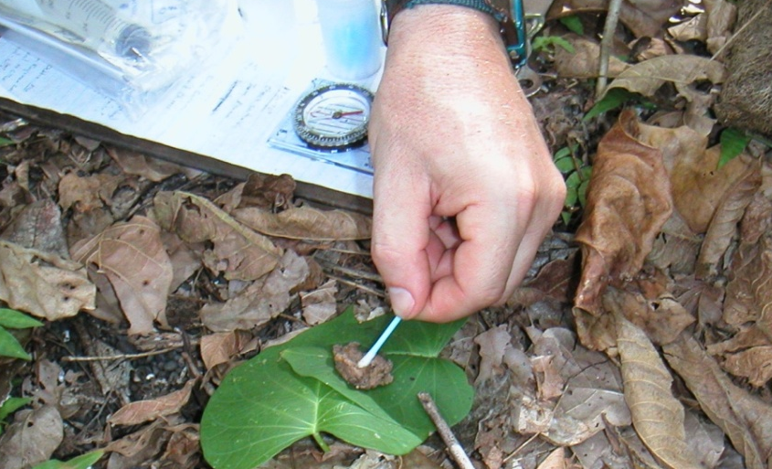
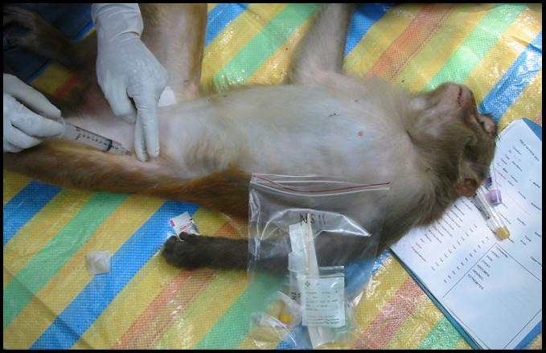
Biological Sampling Methods in the Field
© R. KYES

Slide 3
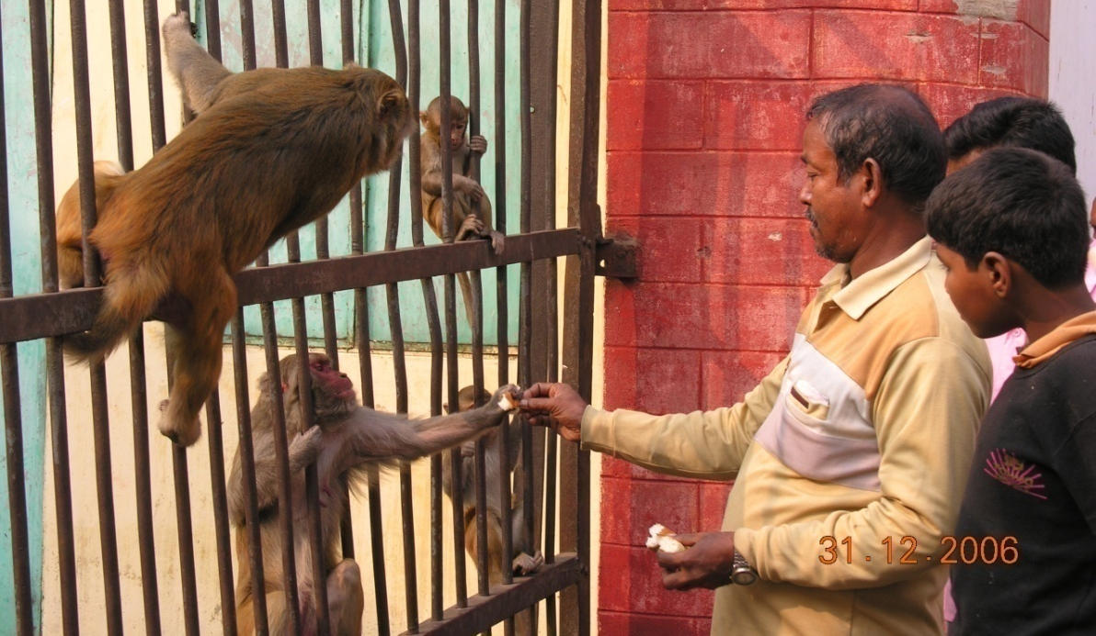
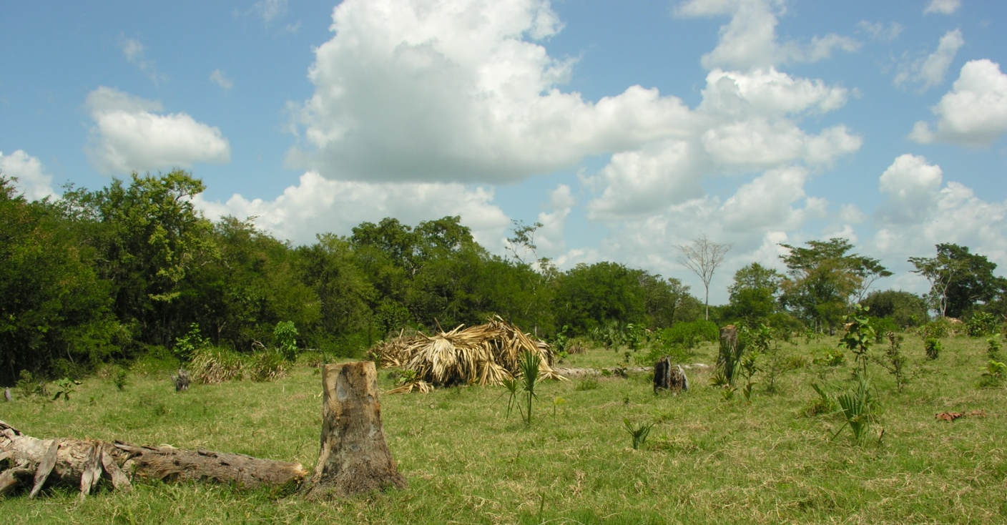
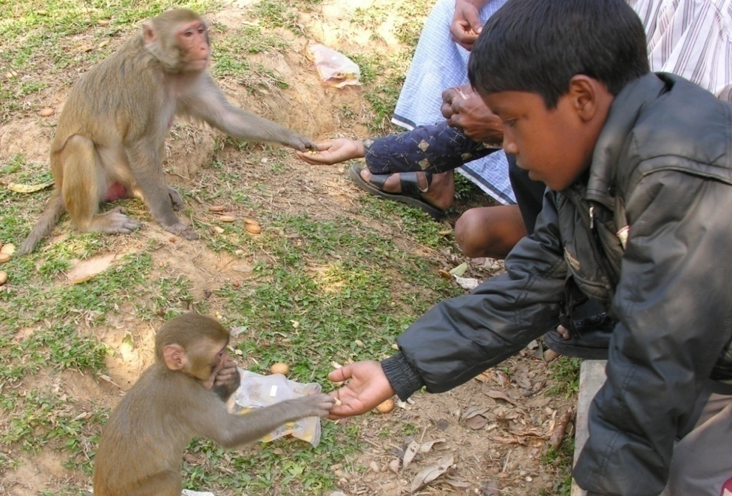
Purpose of Biological Sampling
1) Conservation Biology – to help assess the status of a population.
- Conservation Medicine – health status and health risks
- Conservation Genetics – genetic diversity and long-term viability of a population

Slide 4
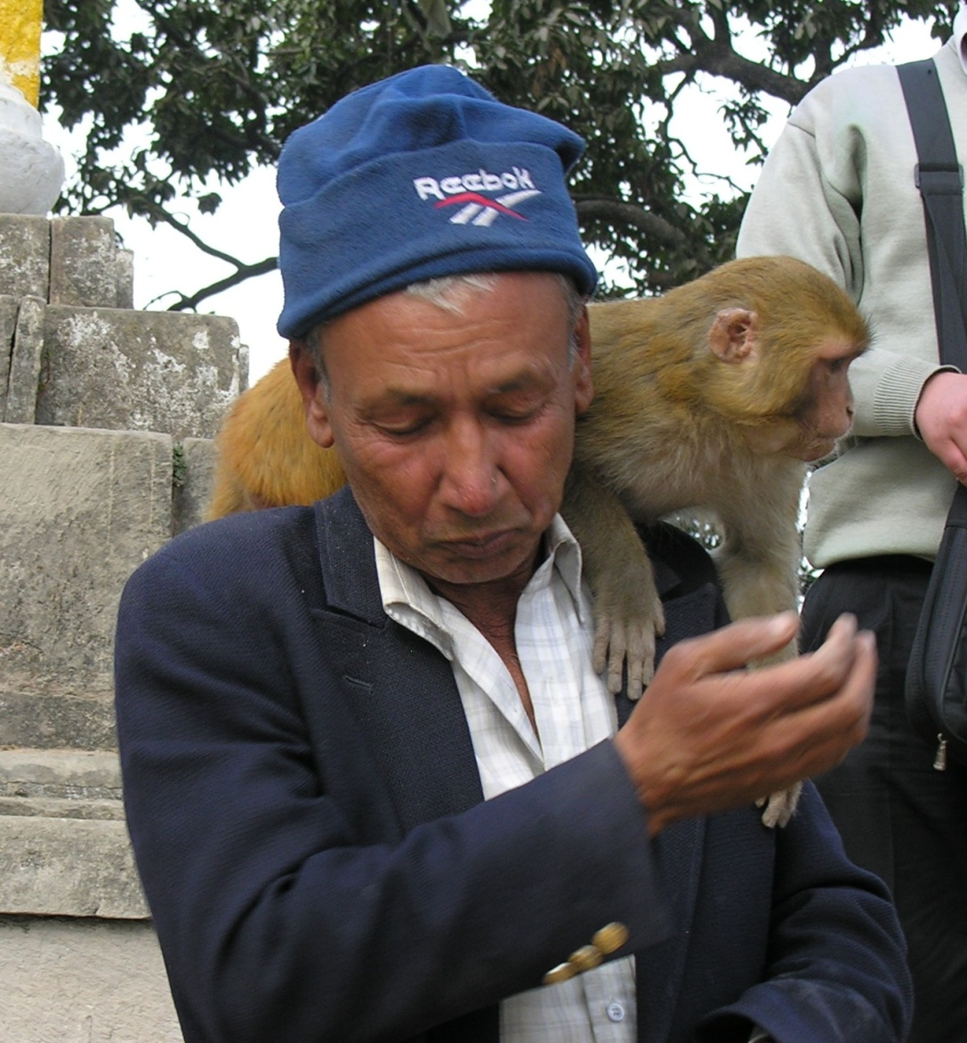
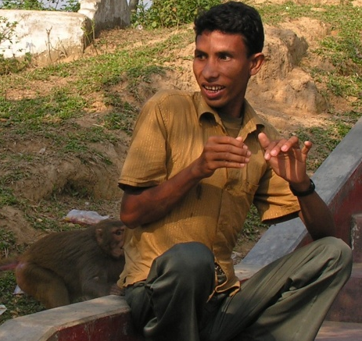
Purpose of Biological Sampling
© R. KYES
2) Emerging Infectious Disease – to help assess the potential health risks to humans
conflict videos

Slide 5
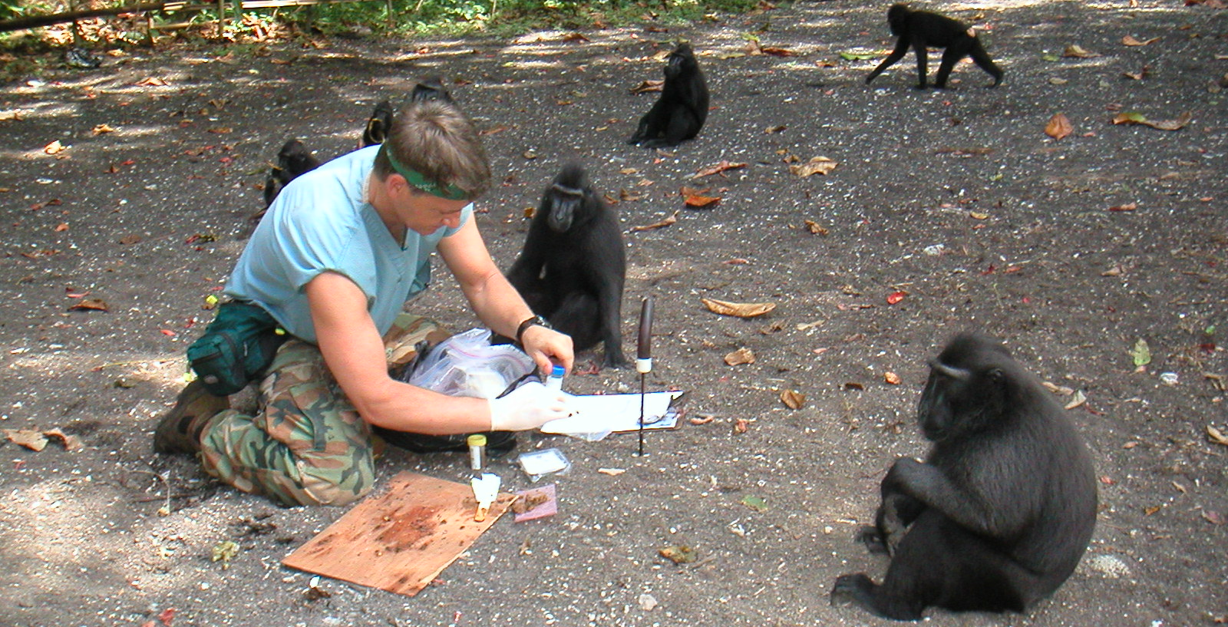
Biological Sample Collection Approaches
1) Non-invasive (“hands off”) - no capture or physical manipulation/handling of the animal.
- Permits limited sample collection (e.g. feces, urine, saliva, fur)
- No risk/harm to the animal; minimal risk to researcher
conflict videos

Slide 6
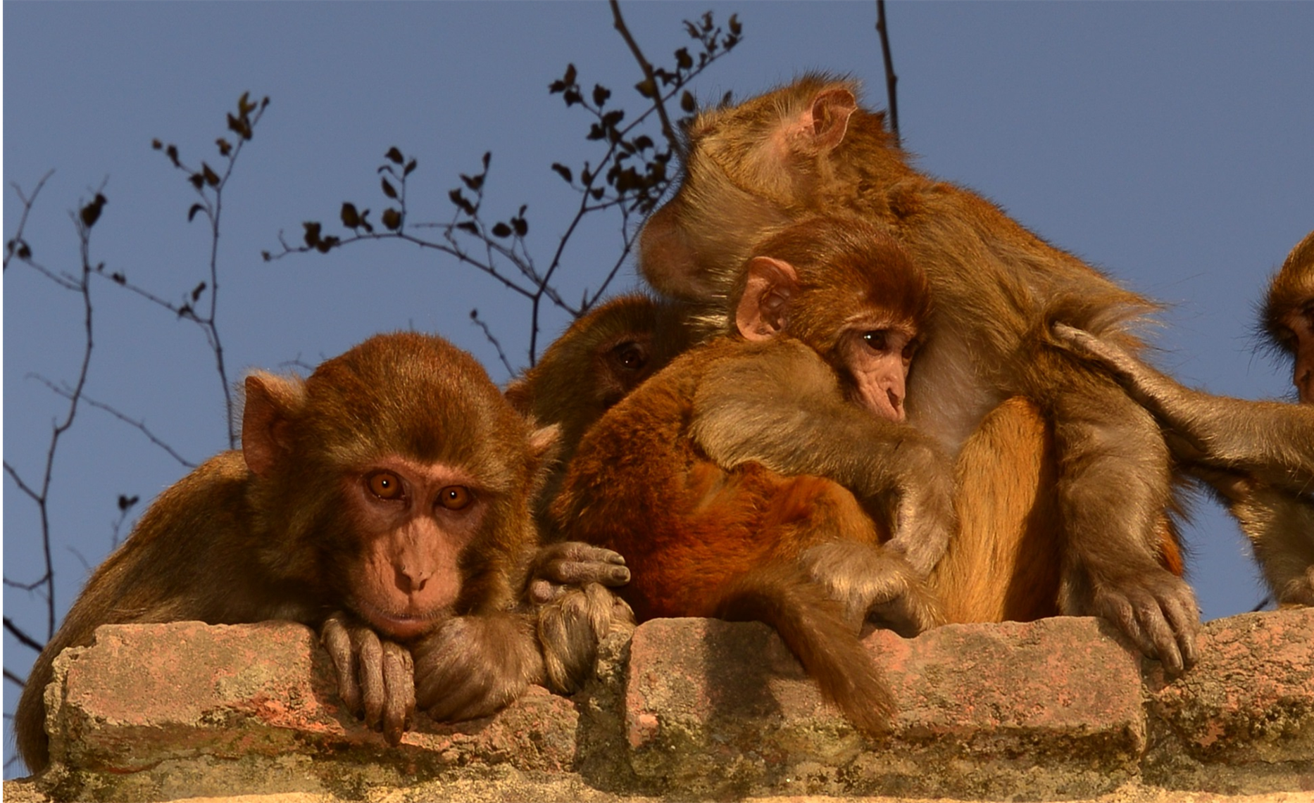
Non-invasive Saliva Collection
To analyze genetics, hormones, bacteria/virus infection

Slide 7
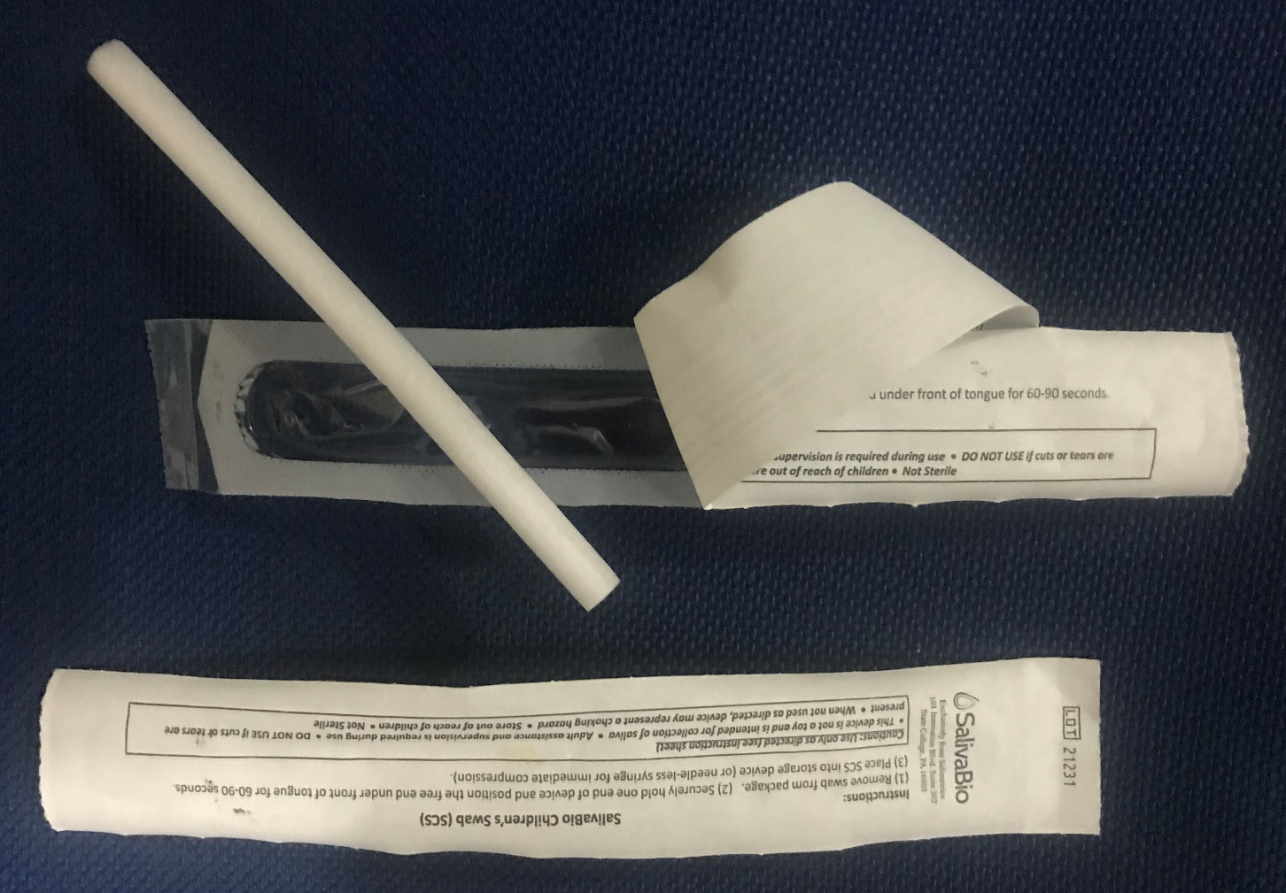
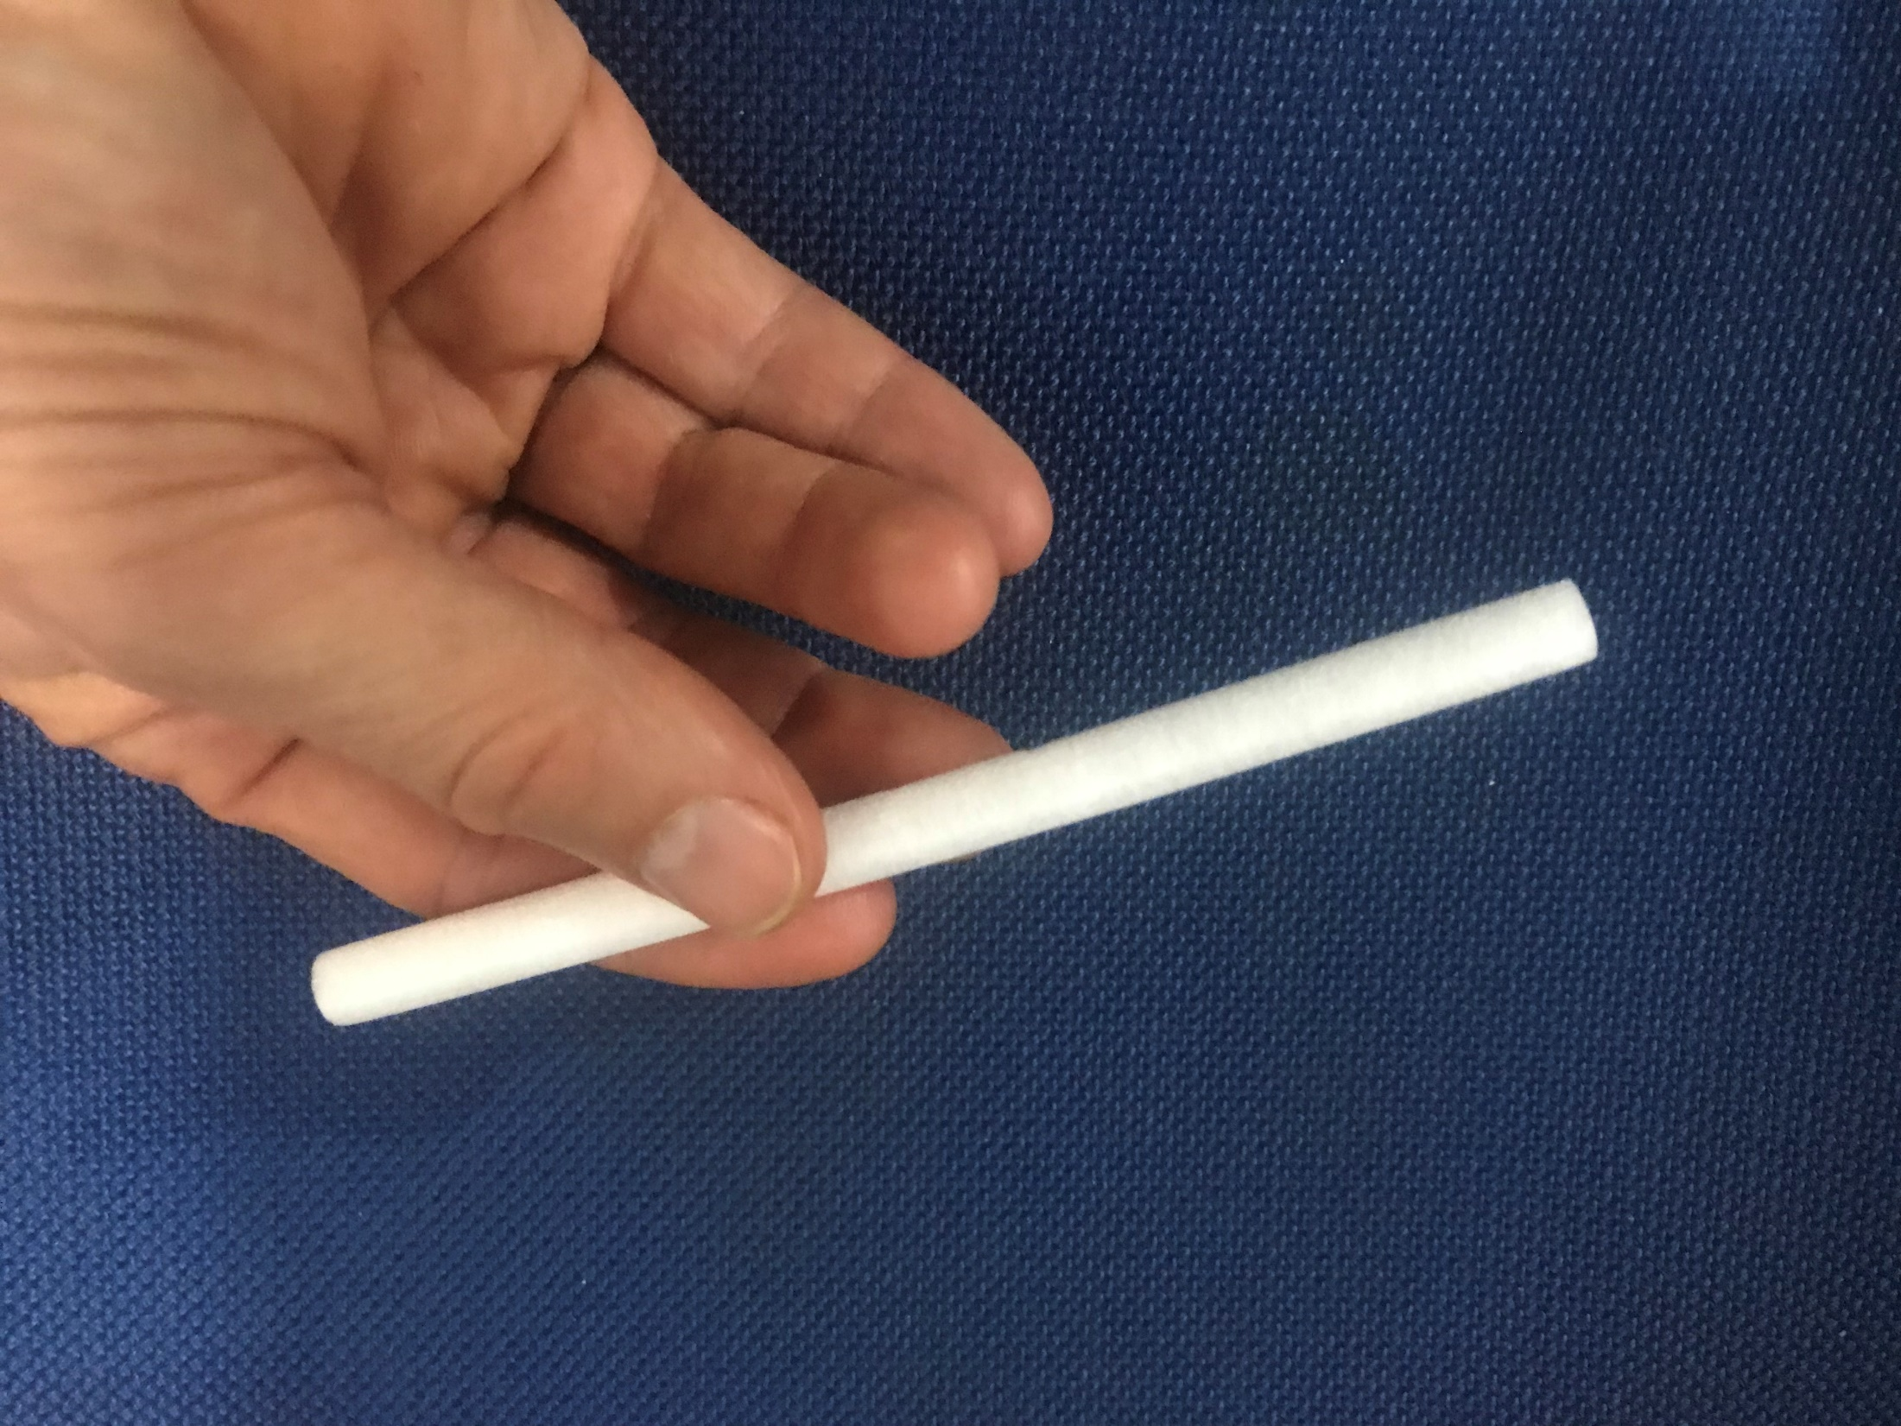

Slide 8
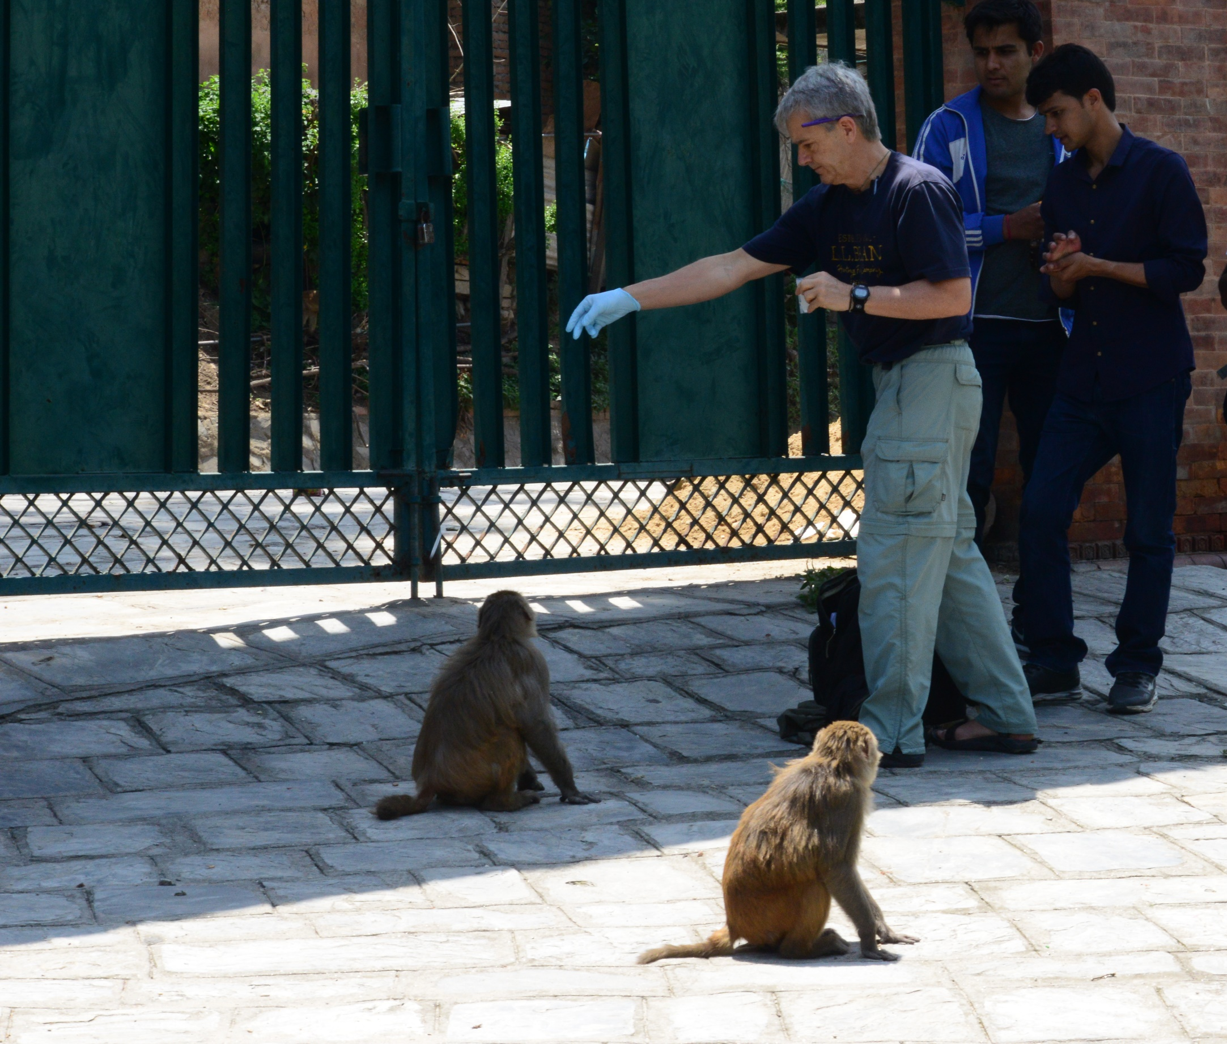

Slide 9
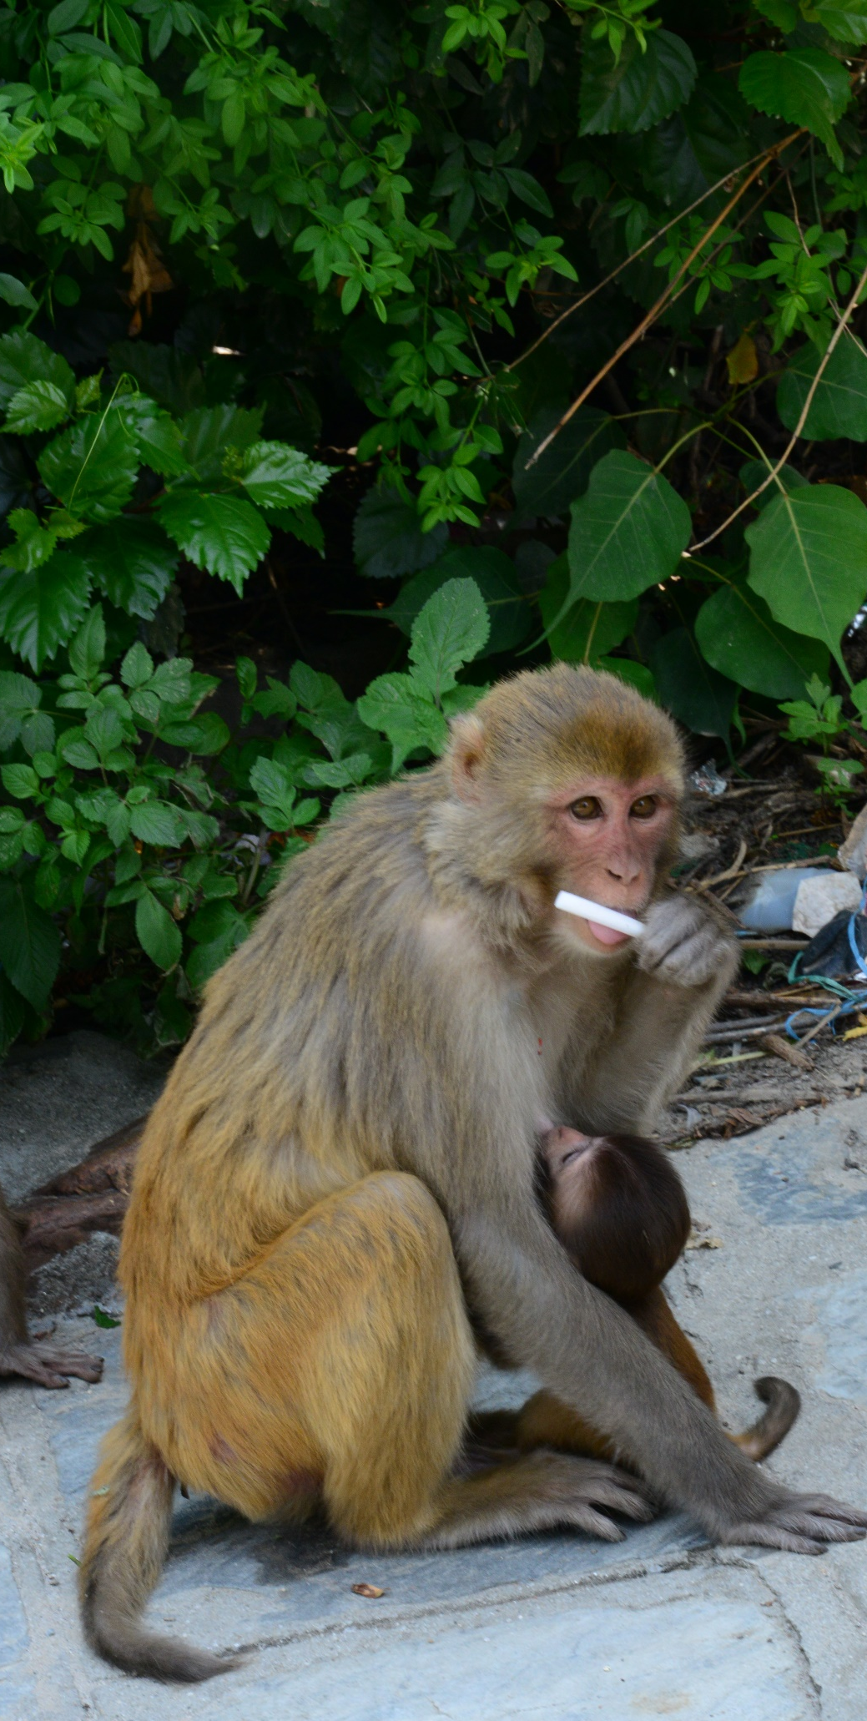
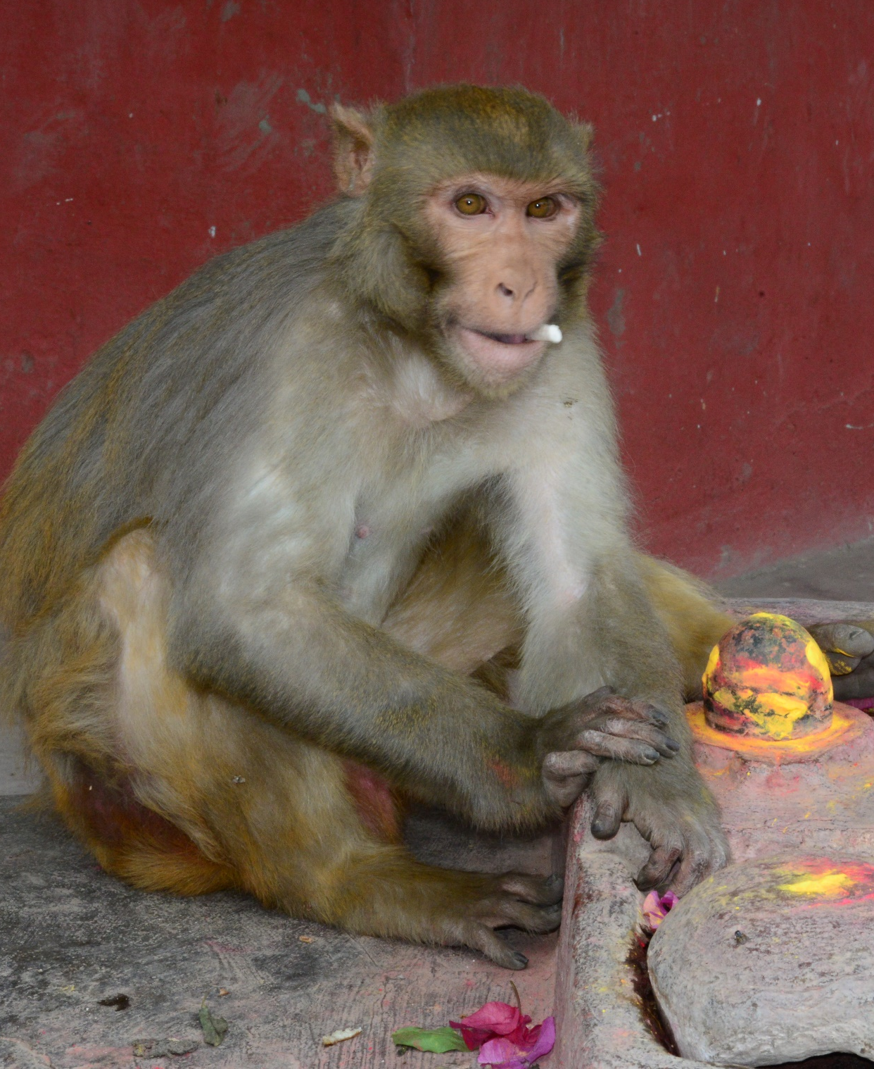

Slide 10
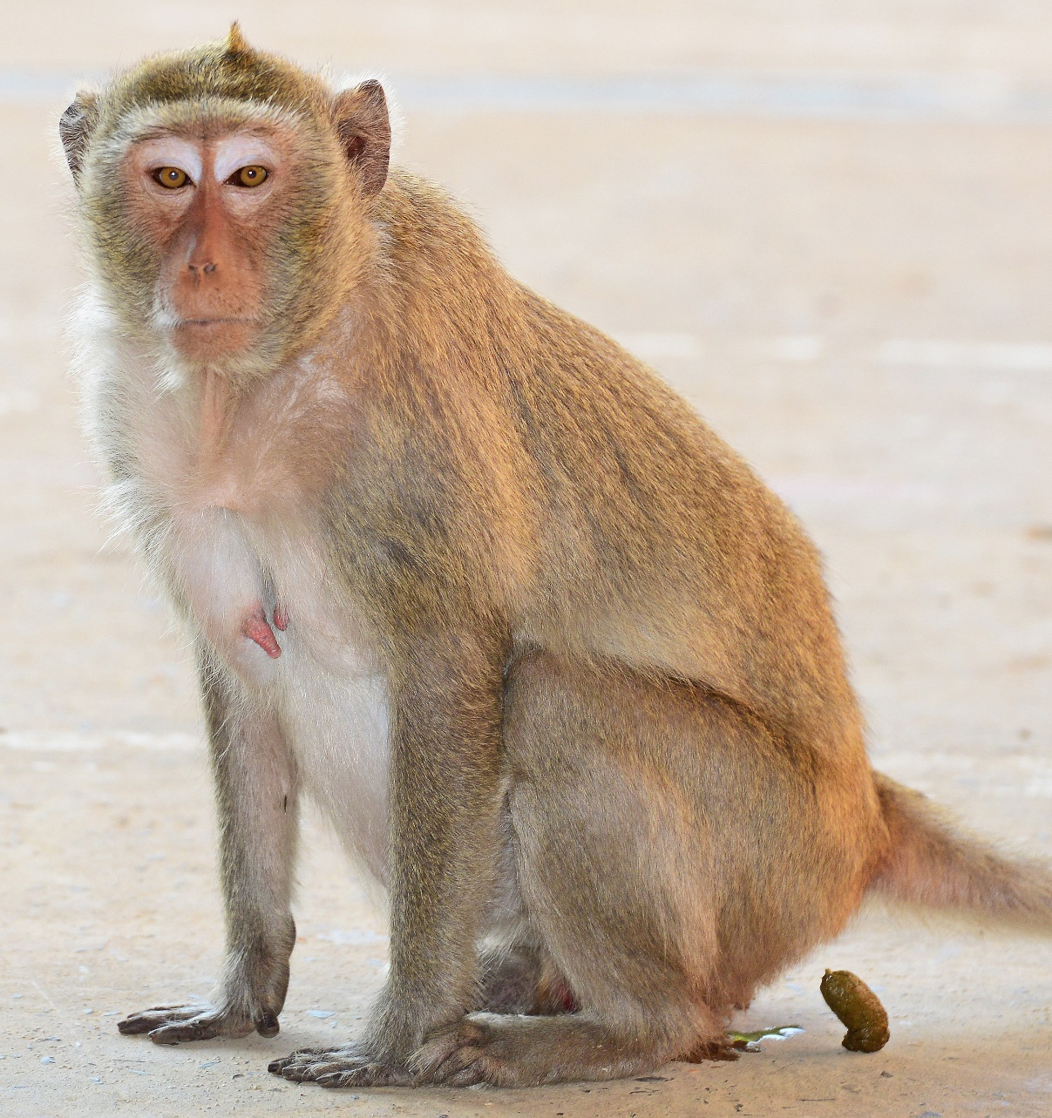
Non-invasive Fecal Collection
To analyze genetics and intestinal parasite infection

Slide 11
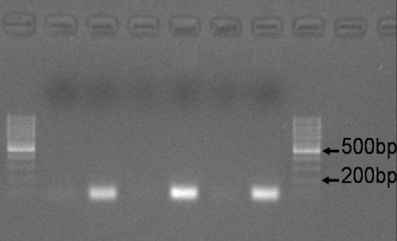
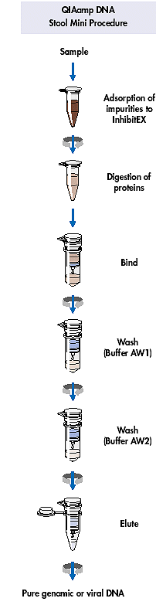
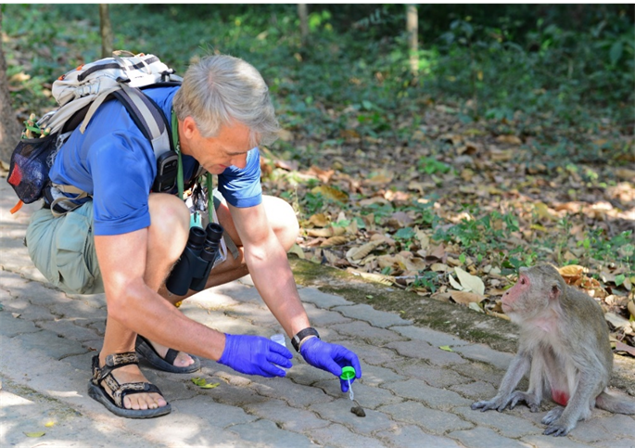

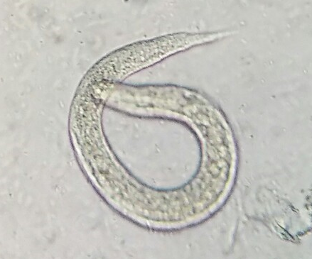
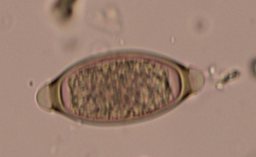
Non-invasive Fecal Collection
To analyze genetics and intestinal parasite infection
Qiagen DNA
Stool mini kit

Slide 12
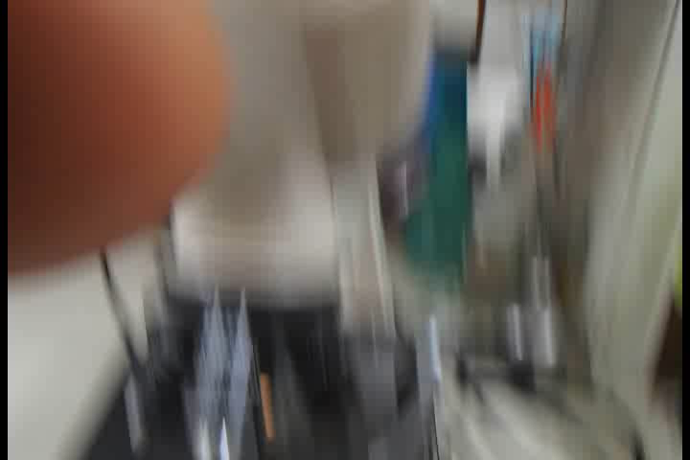
Adult Strongyloides sp., in Long-tailed Macaque
Kosompee, Thailand – Dec 2012

Slide 13
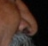
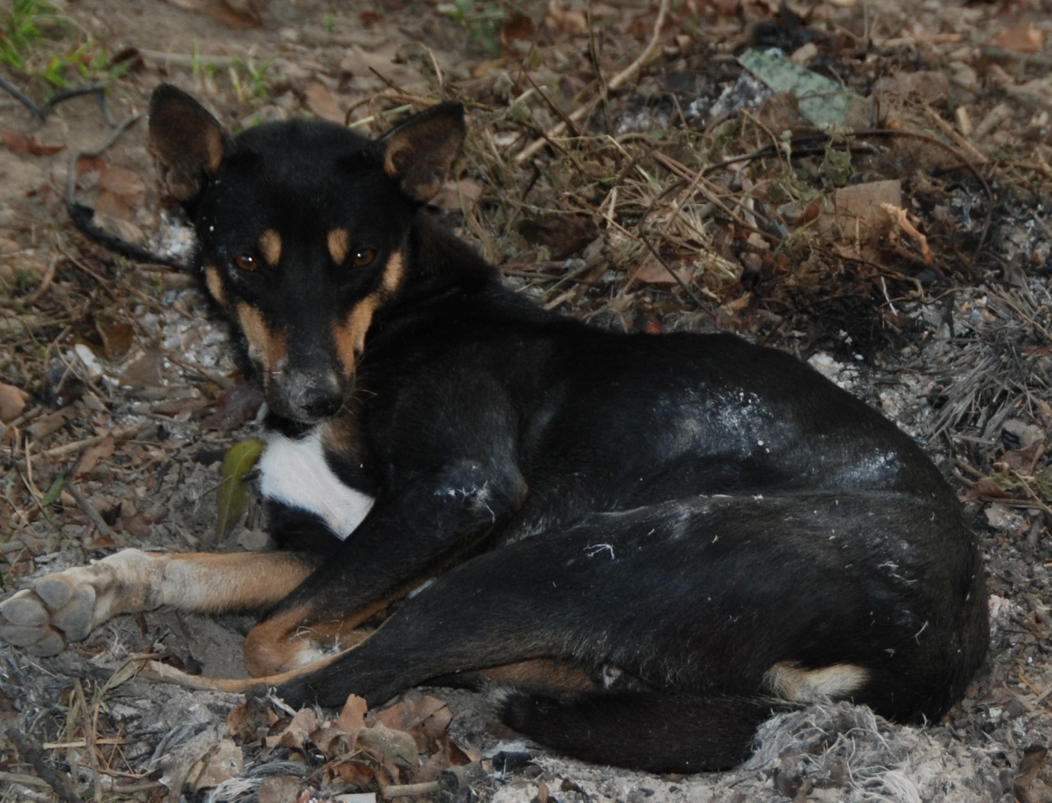
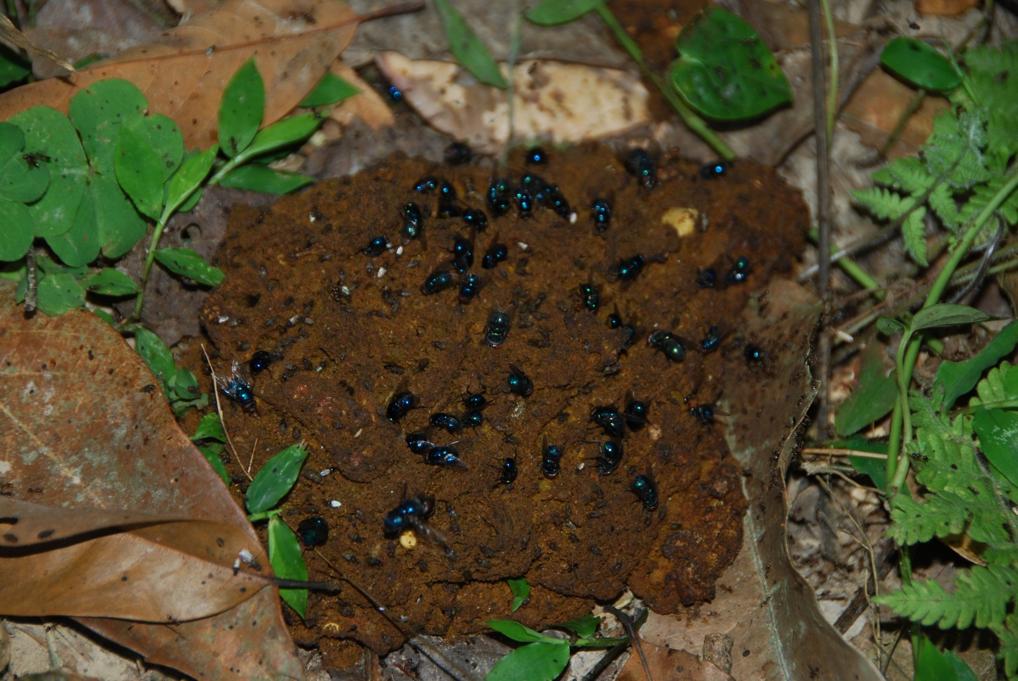
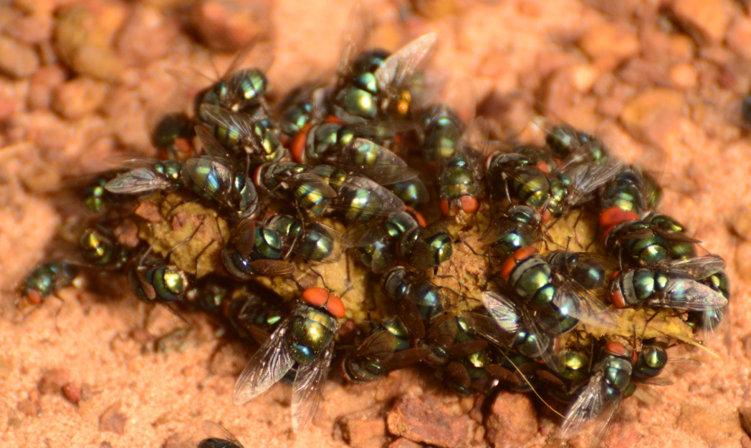
Non-invasive Fecal Collection
How do you find fecal samples in the wild??

Slide 14
Non-invasive Fecal Collection
Data collected per fecal sample:*
1) Sample number (e.g., TK-1, TK2, TK3, etc.)
2) Date
3) Time
4) Animal identifier (name, age/sex class) – or “unknown”
5) Group identifier
6) Location (also GPS reading if possible)
7) Fecal sample description (firm, soft, runny, etc.)
8) Name of collector (or initials)
*also write info on fecal tube

Slide 15
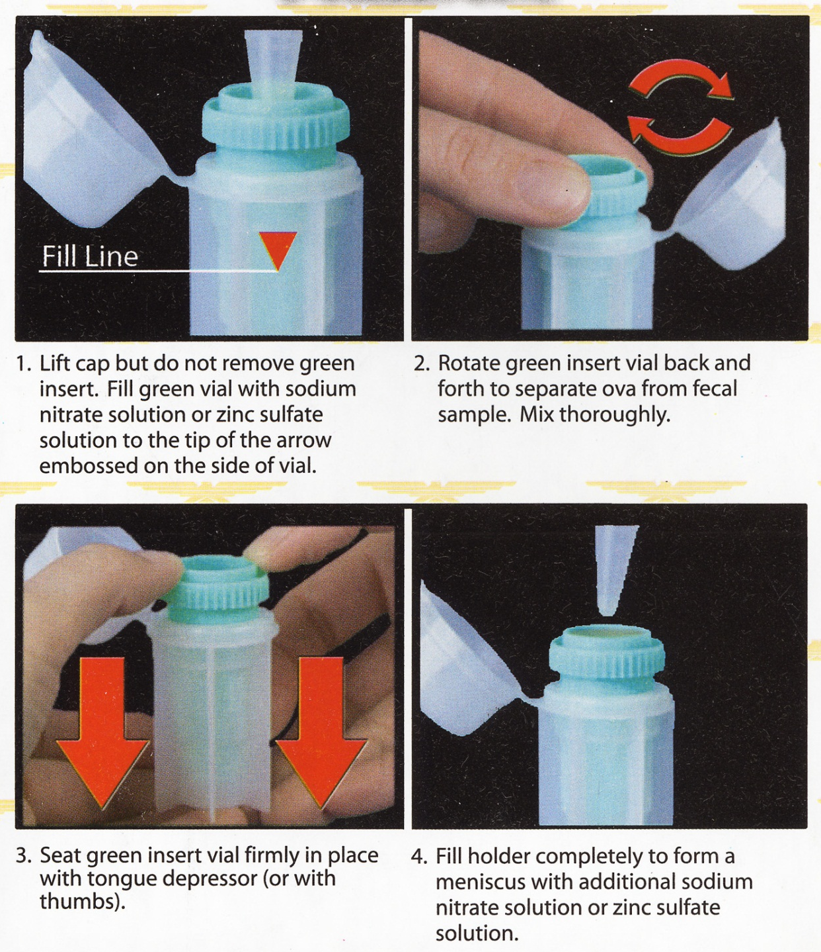


Slide 16
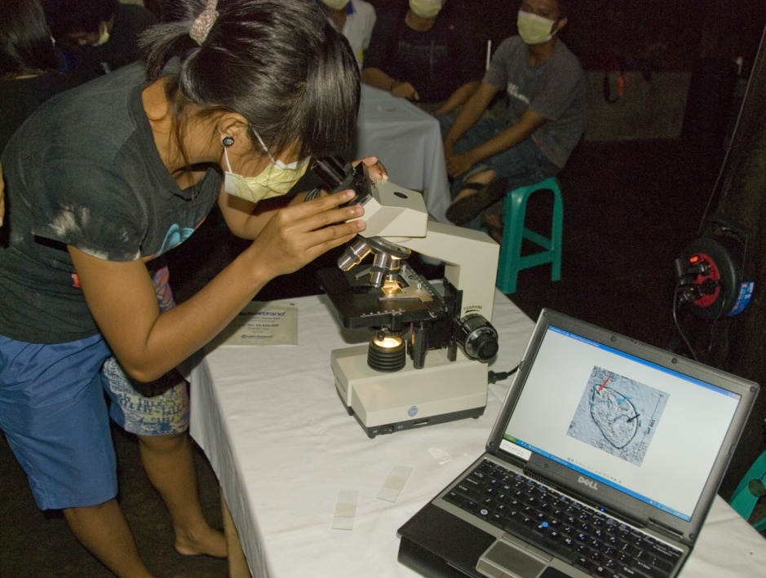

Slide 17
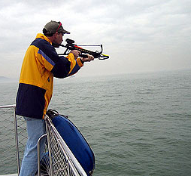
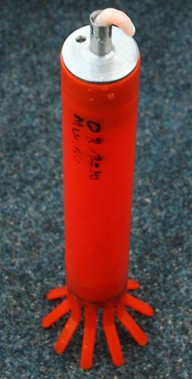
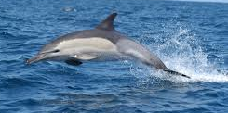
Biological Sample Collection Approaches
2) Semi-invasive – minimal manipulation of the animal
(e.g., via darting, via external device).
- Permits limited sample collection (e.g. tissue (skin) biopsy, saliva, fur)
- Minimal risk/harm to the animal; minimal risk to researcher
lookfordiagnosis.com
photo: gov.hk mucru.org

Slide 18
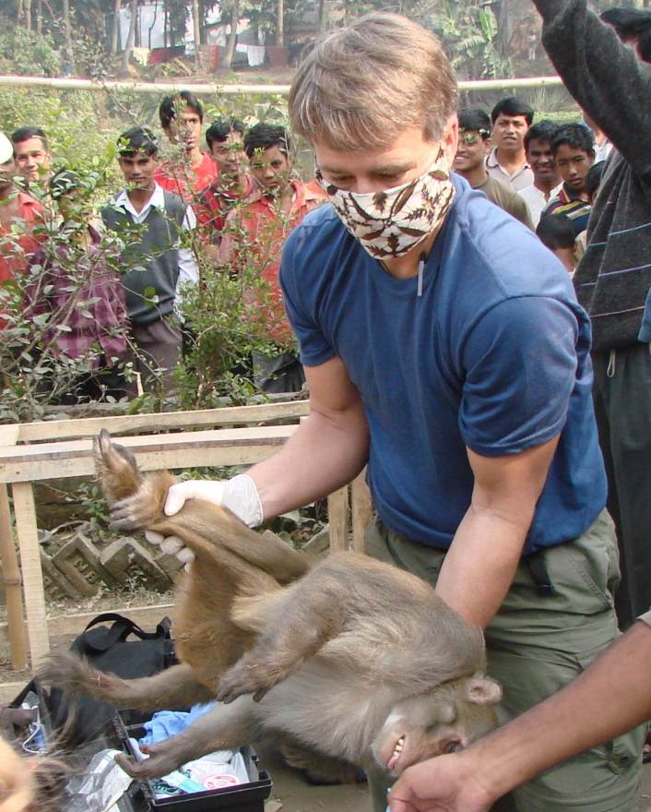
Biological Sample Collection Approaches
3) Invasive (“hands on”) - requires capture and physical restraint of the animal .
- Permits acquisition of all possible biological sample (e.g., blood,
tissue biopsy, mucosal swabs, feces, urine, saliva, fur)
- Greater potential for risk/harm to the animal
and researcher

Slide 19
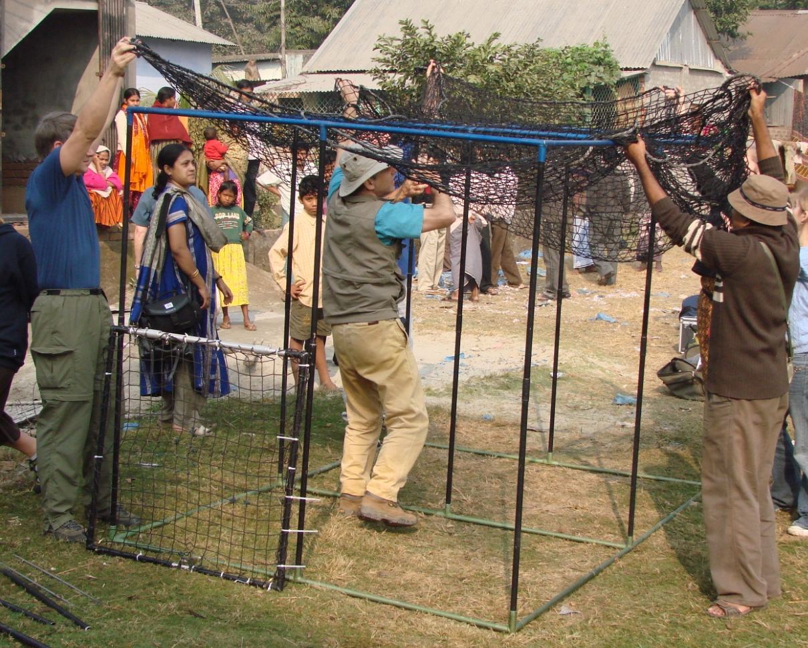
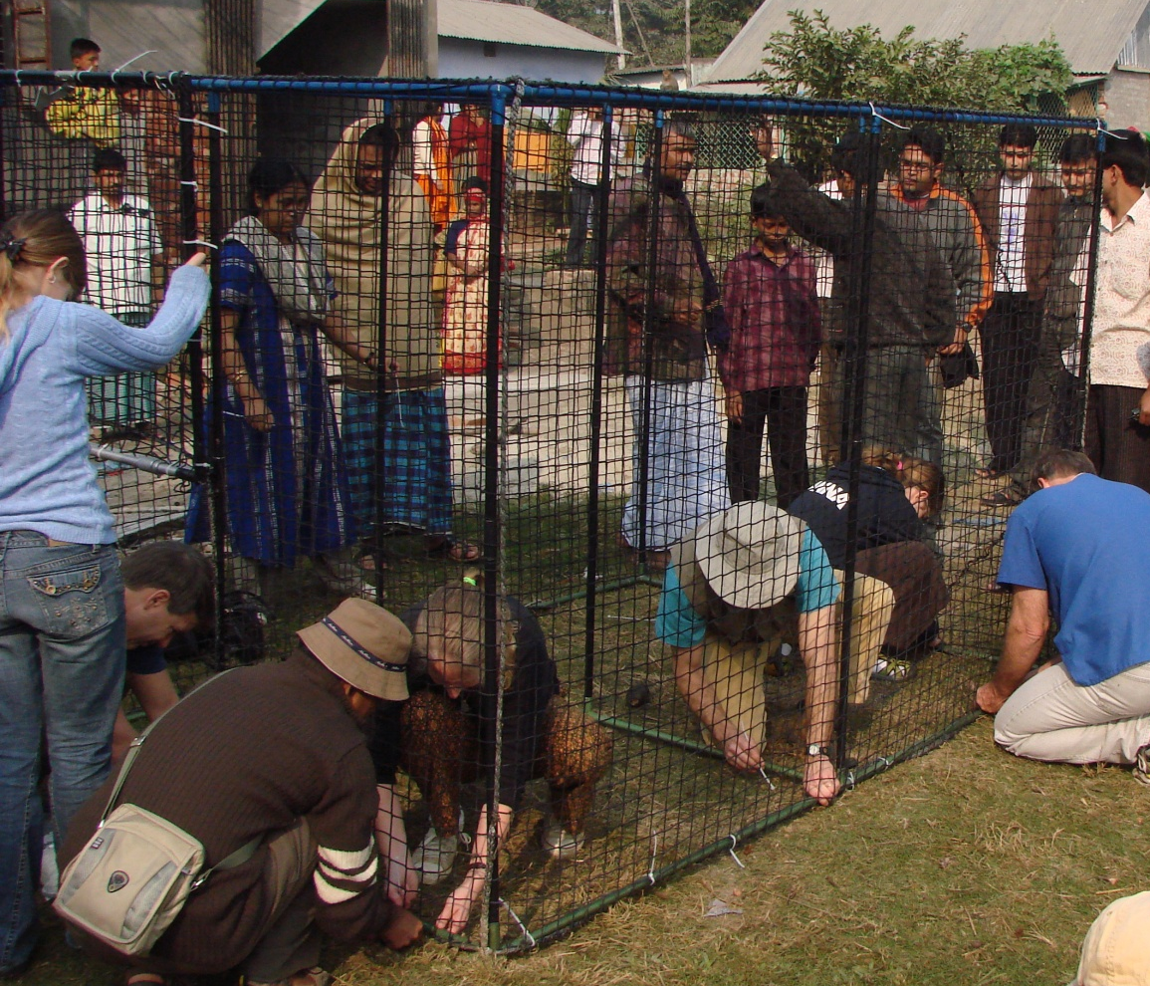
Capture Techniques
© R. KYES
1) Trapping - wide variety of trapping cage designs and techniques.

Slide 20
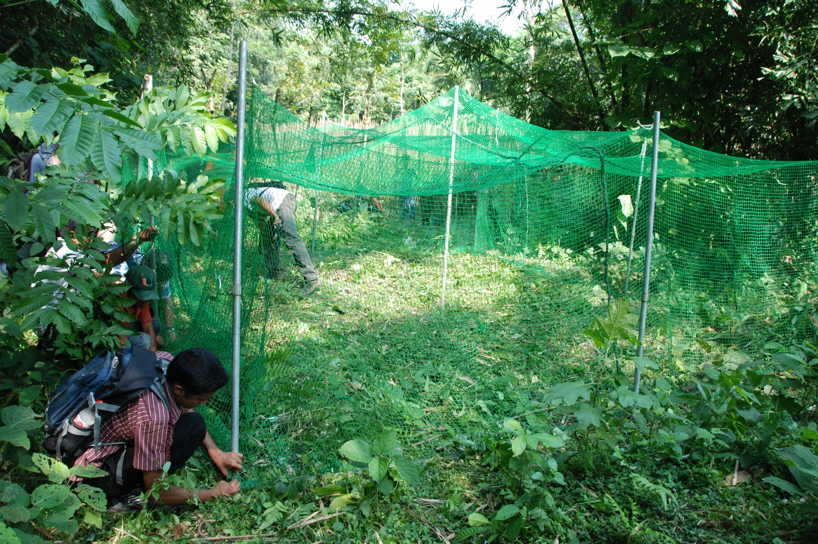

Slide 21
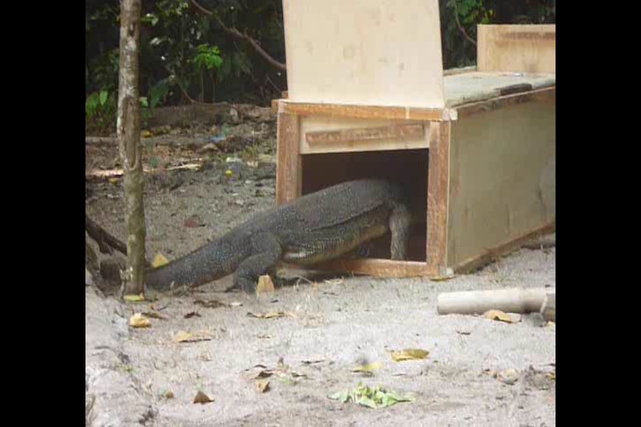

Slide 22
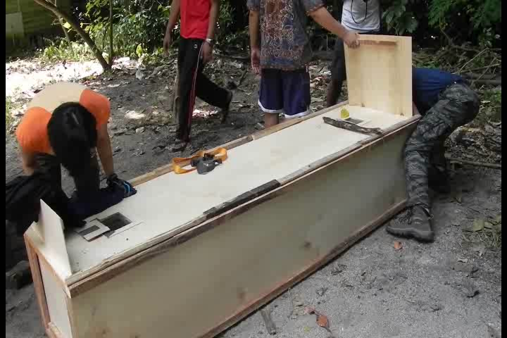

Slide 23
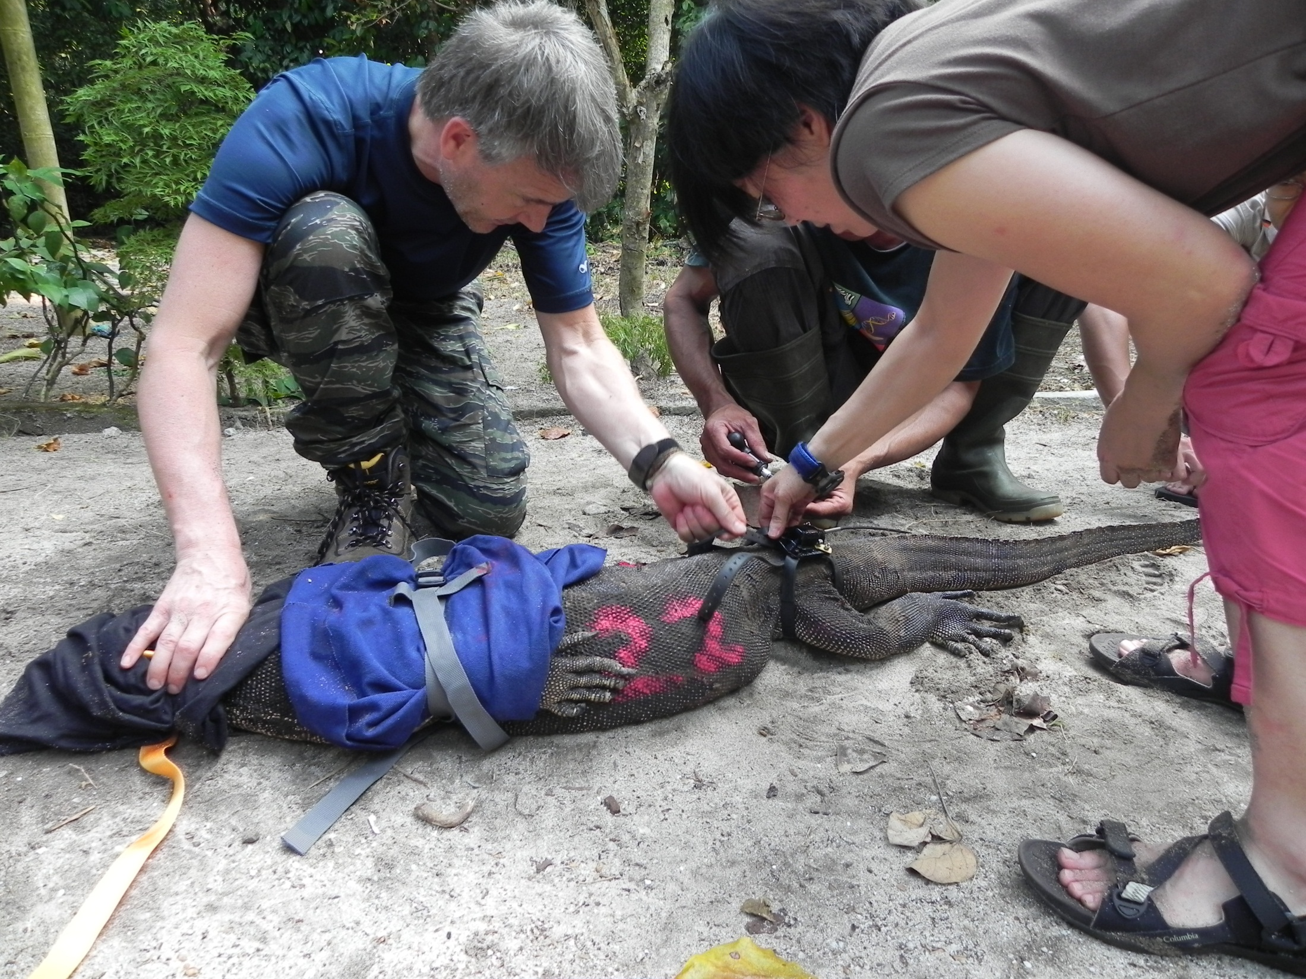

Slide 24
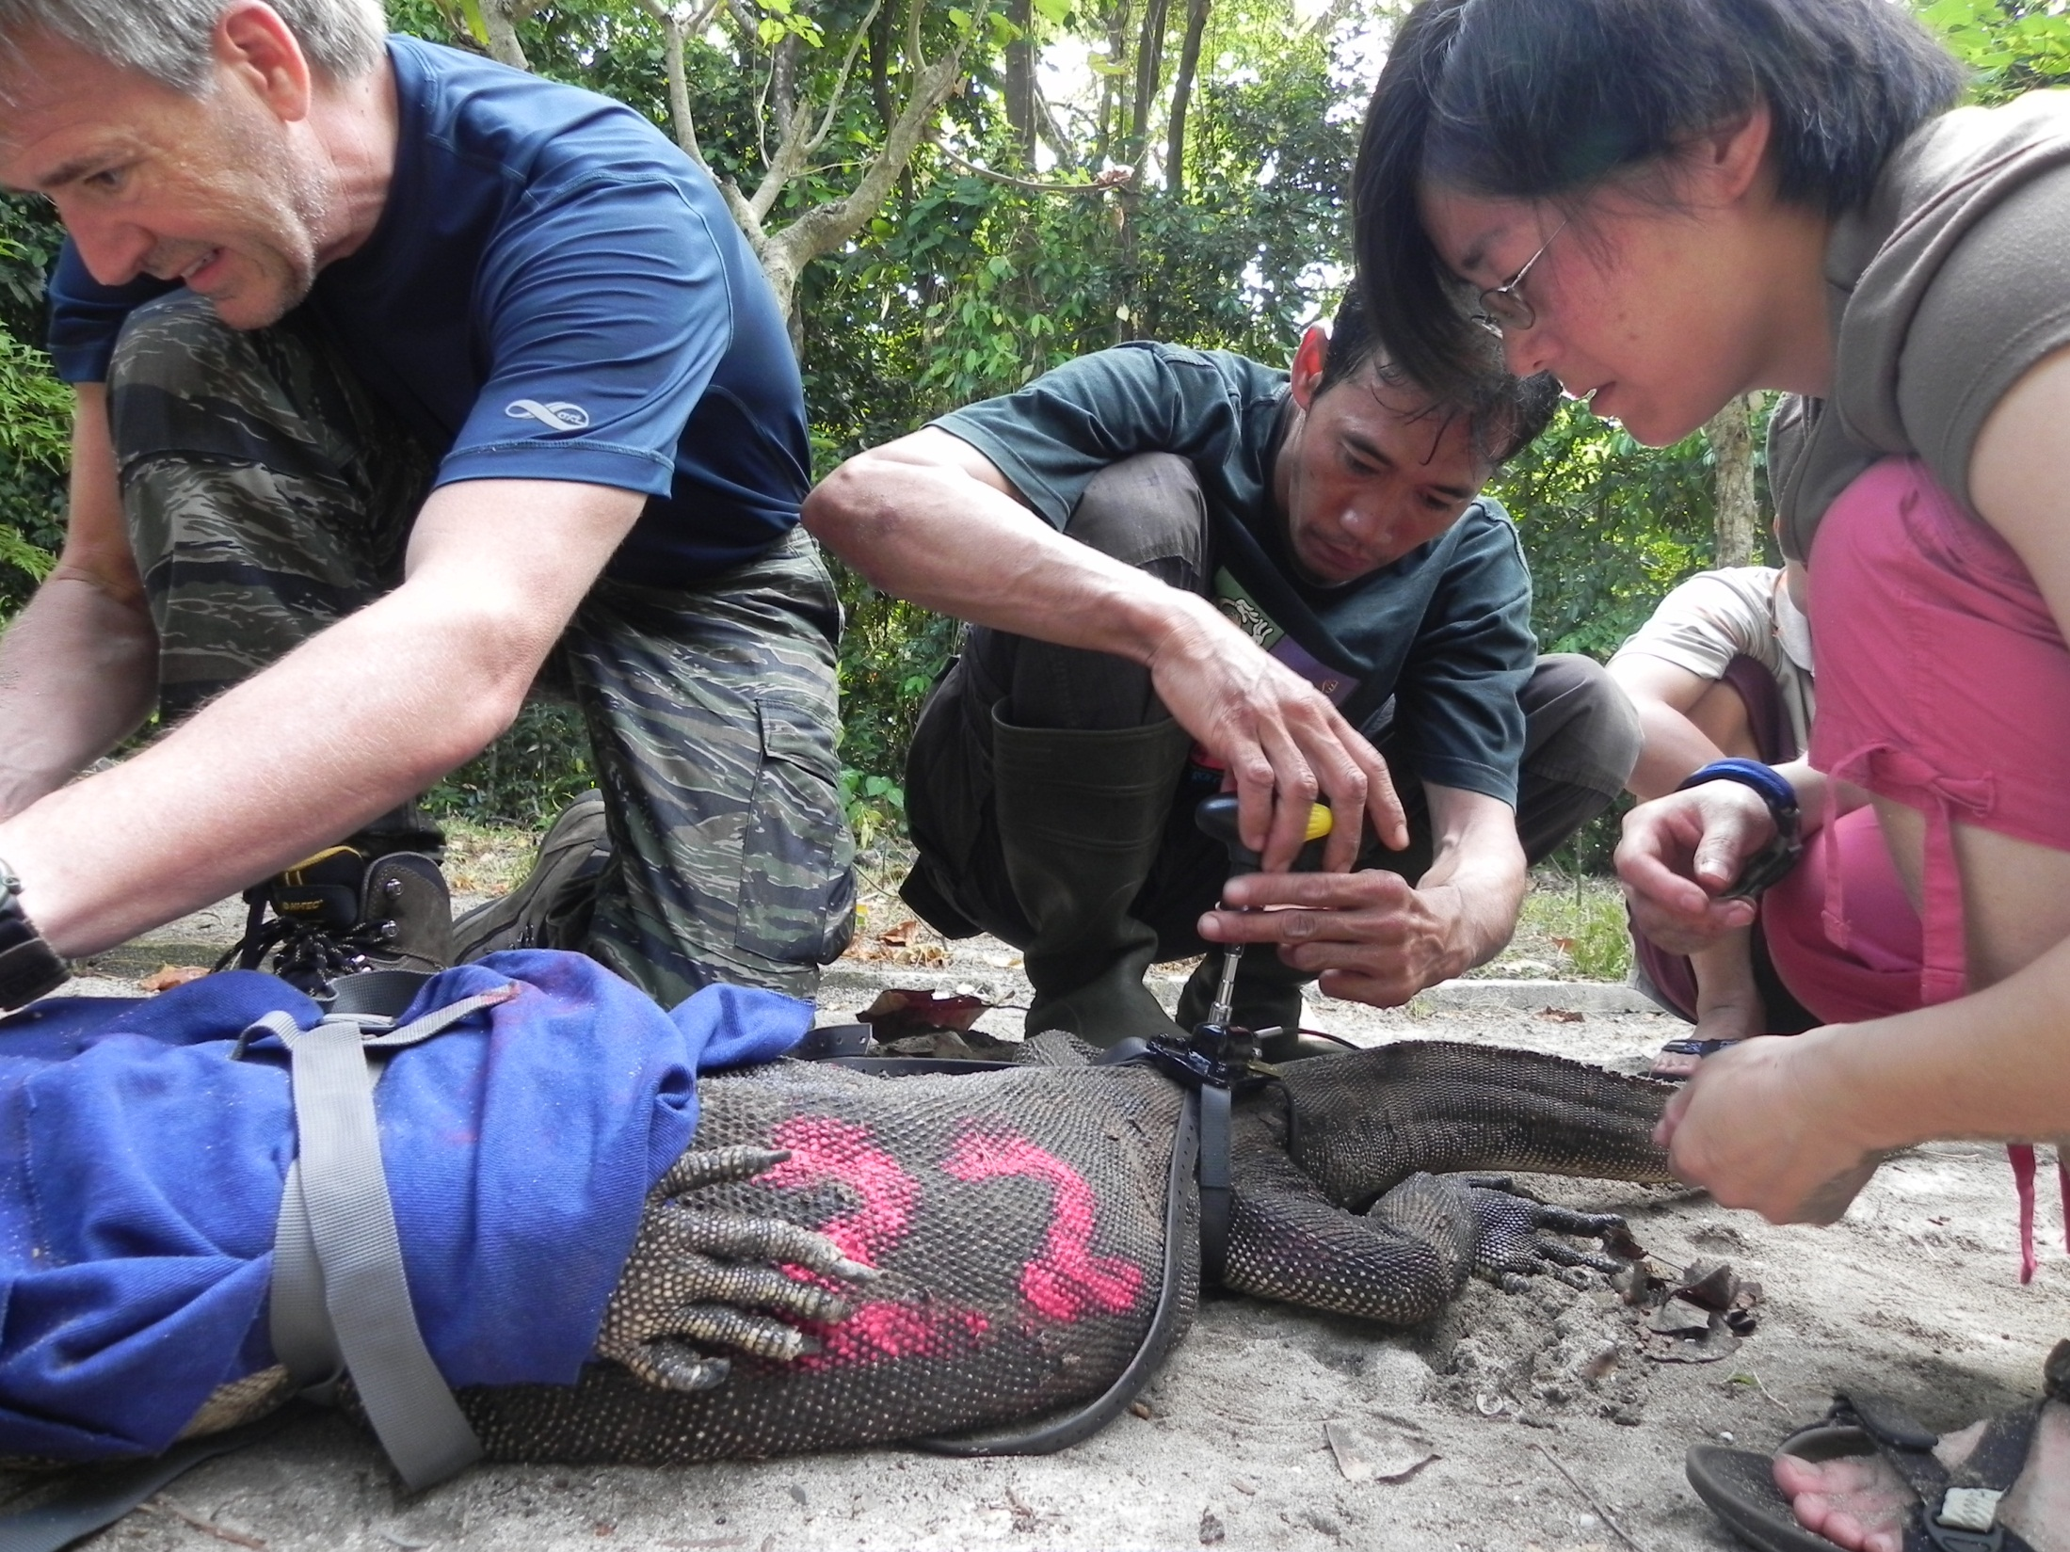

Slide 25
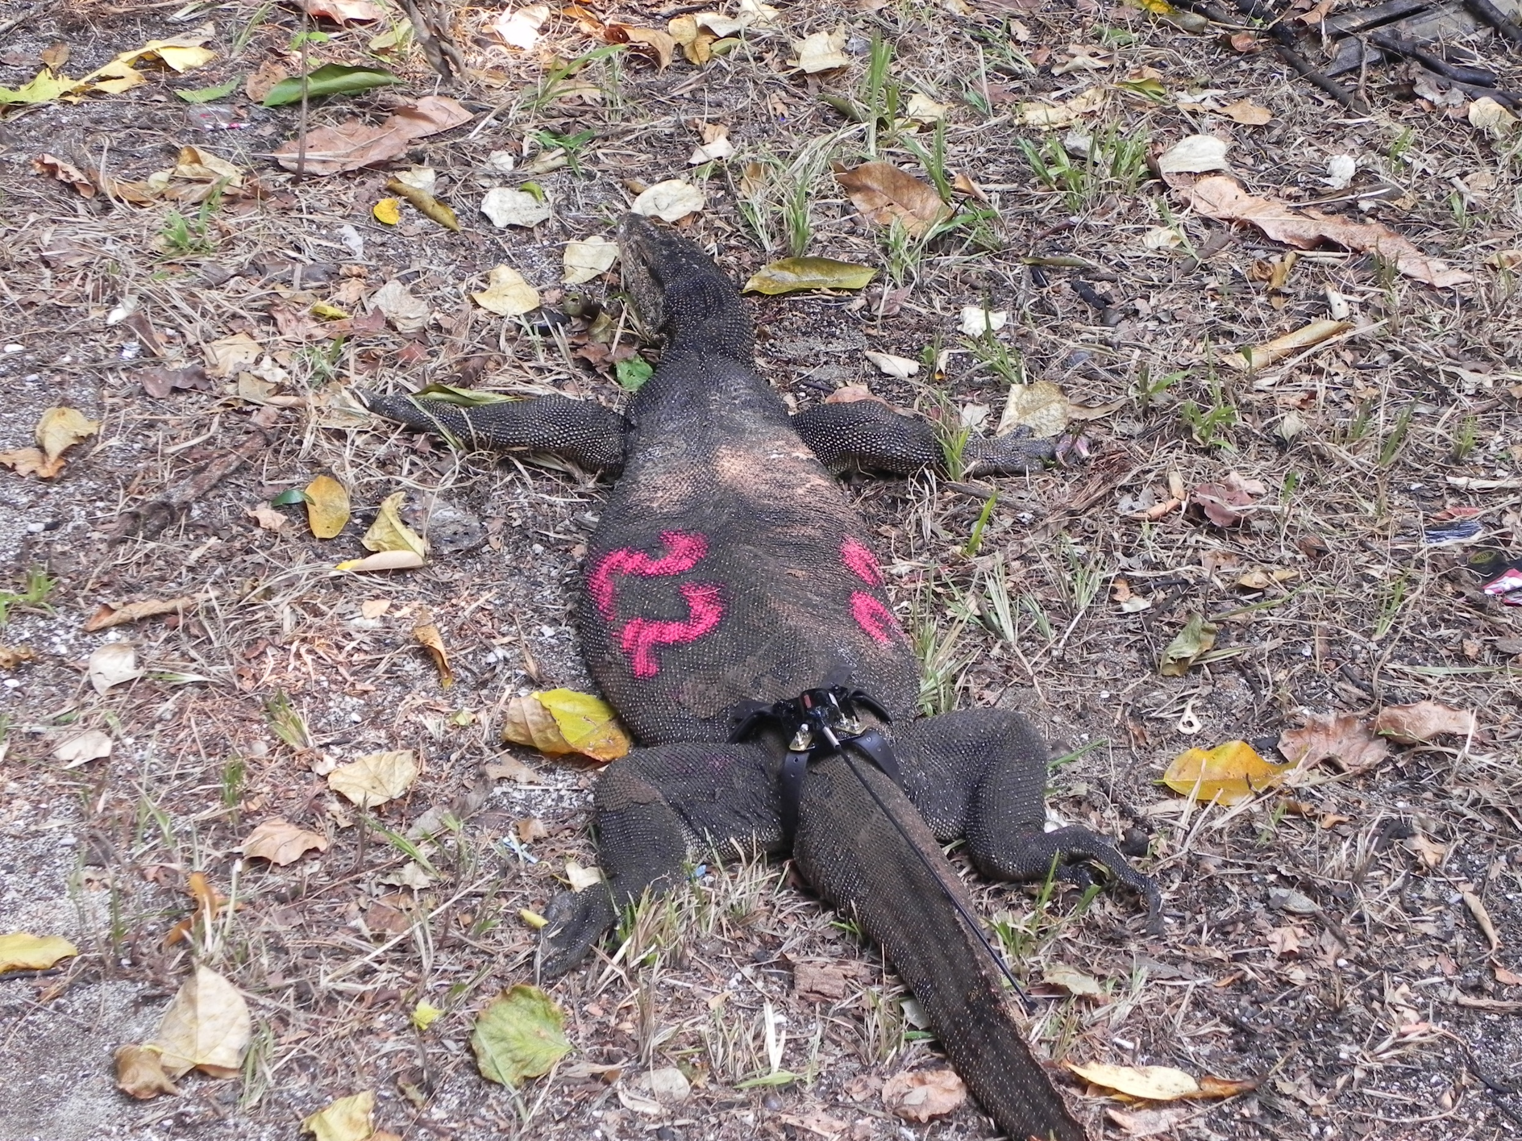

Slide 26
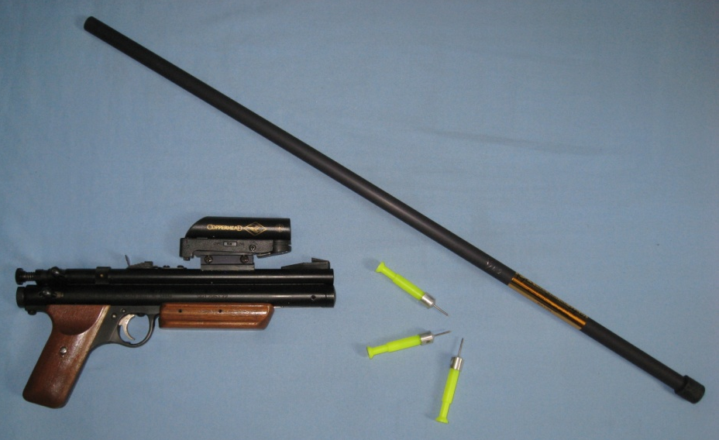
Capture Techniques
1) Trapping
2) Darting - via blowgun, dart gun

Slide 27
Capture Techniques
1) Trapping - wide variety of trapping cage designs and techniques.
2) Darting - via blowgun, dart gun
3) Chemical Immobilization – sedation/anesthesia – to permit safe biological sample collection
(e.g., ketamine hydrochloride)

Slide 28



Slide 29

Biological Sample Collection
1) Conduct general veterinary exam - to insure that the anaesthetized animal is stable (good vitals)

Slide 30

Biological Sample Collection
1) Conduct general veterinary exam
2) Clinical exam – general appearance, wounds, injuries, etc., dentition, morphometrics.

Slide 31

Biological Sample Collection
1) Conduct general veterinary exam
2) Clinical exam
3) Blood sample
(via Femoral triangle or
Saphenous vein)
-virus evaluation
-bacterial evaluation
-genetic analysis
-health measures
-etc.

Slide 32

Biological Sample Collection
1) Conduct general veterinary exam
2) Clinical exam
3) Blood sample
4) Fecal sample
-intestinal parasites
-genetic analysis
-endocrine measures

Slide 33
Biological Sample Collection
1) Conduct general veterinary exam
2) Clinical exam
3) Blood sample
4) Fecal sample
5) Urine
6) Swabs (nose, mouth, rectal, genital, fresh wounds) -
7) Fur/Hair
8) Skin biopsy

Slide 34

Biological Sample Collection
Post-anesthesia recovery - Allow the animals to fully recover from anesthesia prior to release back to the group/wild.

Slide 35
Biological Sample Collection
REMEMBER:
- Obtain all necessary permits/permission for sample collection and transport . (Including local, national, and international permits).
- Obtain Institutional Animal Care and Use Committee approvals for your project. Many scientific journals now require a statement that your research complied with the animal care protocols approved by your institution’s IACUC.

